Slide 1

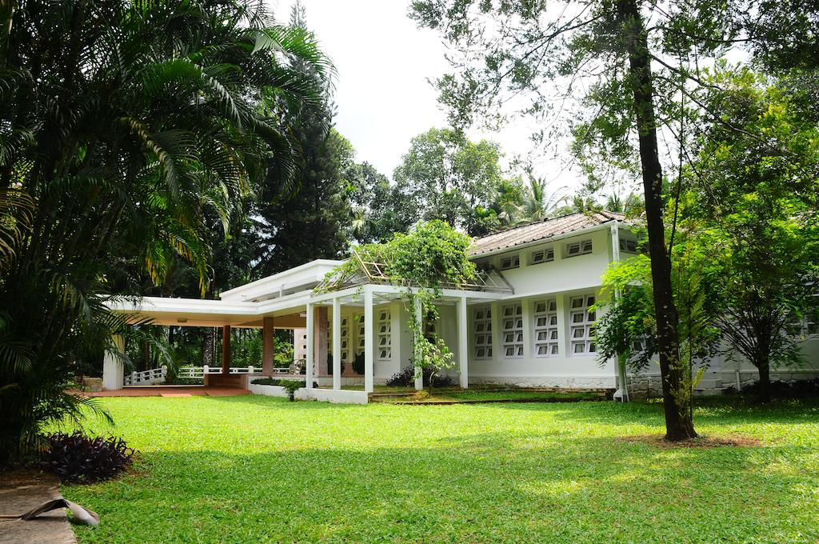
8888

Slide 2

8888

